Slide 1
Finding Services Using Service Discovery

Slide 2

Service Discovery
Outline
Discovering Services with Spring Cloud
Using Eureka client and server
Configuration
Health & High Availability
Dashboard
AWS Support

Slide 3
What is Service
Discovery and why do we need it?

Slide 4
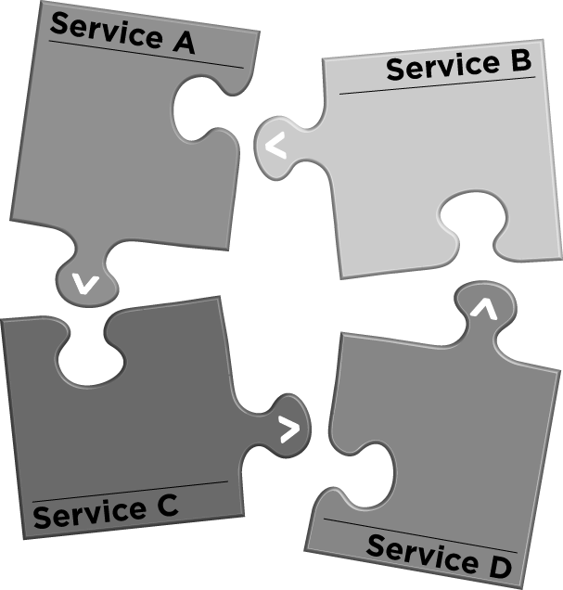
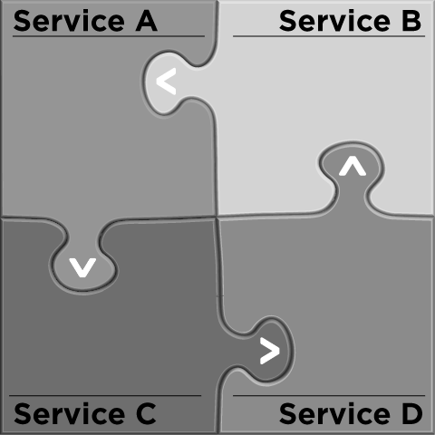
Changes in the Way We Develop Software
From single applications
To individually deployable services

Slide 5



The Problem: How Does One Service Locate Another?
Application Service A
Locate?
Application Service B

Slide 6

The Simple Approach: Via Configuration
Application Service A
Configuration File
B: http://1.2.3.4:6500/
Application Service B

Slide 7

Multiple Instances
Instance 1
Instance 2
HTTP REST
Application Service A
Application Service B

Slide 8
Instances Come and Go in Response to Demand
Instance 1
Instance 2
Instance 3
Instance 4
HTTP REST
Application Service A
Application Service B

Slide 9

Instances Fail
Instance 1
Instance 2
HTTP REST
Application Service A
Application Service B

Slide 10

The simple approach is far too static (frozen in time) for
the cloud!

Slide 11


Service discovery provides
A way for a service to register itself
A way for a service to deregister itself
A way for a client to find other services
A way to check the health of a service and remove unhealthy instances

Slide 12
Discovering Services With Spring Cloud

Slide 13

discover services with: Spring Cloud Consul Spring Cloud Zookeeper Spring Cloud Netflix

Slide 14
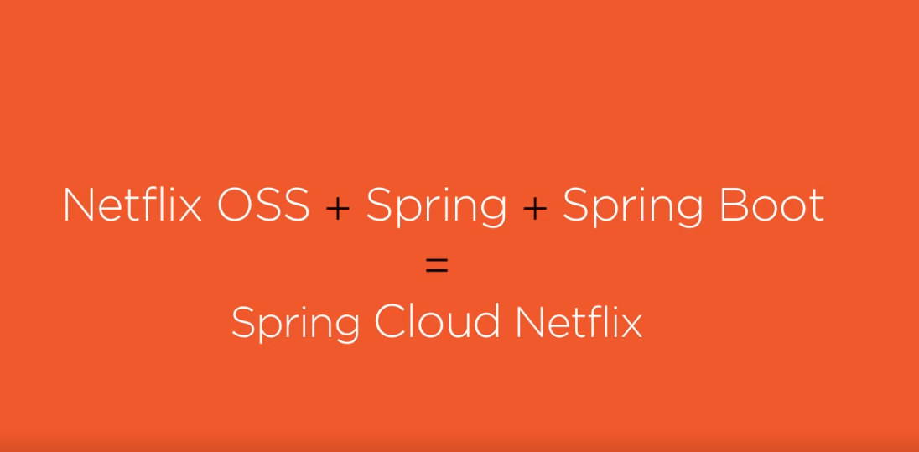

Slide 15


Spring Cloud Netflix
Spring Cloud Netflix Eureka Server
Spring Cloud Netflix Eureka Client
Other Spring Cloud Netflix Projects

Slide 16


Key Components in Service Discovery
Discovery Server
Service
Client

Slide 17
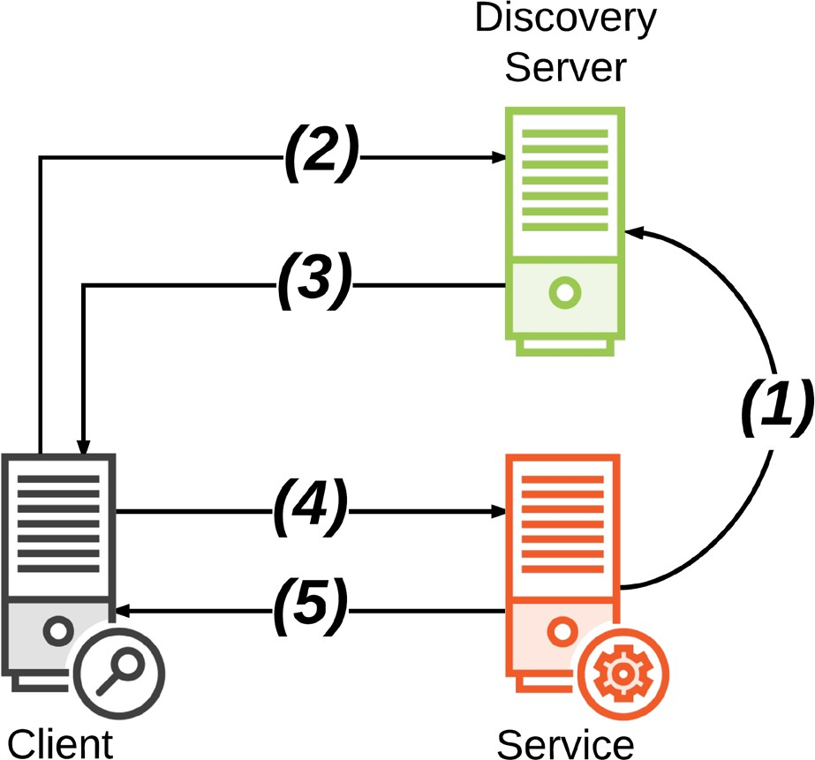
Service registers location
Client looks up service location
Discovery server sends back location
Client requests service at location
Service sends response

Slide 18
Discovery
An actively managed registry of service locations
Source of truth
One or more instances Spring Cloud Project:
- Spring Cloud Eureka Server
Server

Slide 19
Using Spring Cloud Eureka Server
pom.xml
<dependencyManagement>
<dependencies>
<dependency>
<groupId>org.springframework.cloud</groupId>
<artifactId>spring-cloud-dependencies</artifactId>
<version>Camden.SR2</version>
<type>pom</type>
<scope>import</scope>
</dependency>
</dependencies>
</dependencyManagement>

Slide 20
Using Spring Cloud Eureka Server
pom.xml
<dependency>
<groupId>org.springframework.cloud</groupId>
<artifactId>spring-cloud-starter-eureka-server</artifactId>
</dependency>

Slide 21
Using Spring Cloud Eureka Server
application.properties
spring.application.name=discovery-server
OR
application.yml
spring: application:
name: discovery-server

Slide 22
Using Spring Cloud Eureka Server
Application.java
@SpringBootApplication
@EnableEurekaServer
public class Application {
public static void main(String[] args) { SpringApplication.run(Application.class, args);
}
}

Slide 23
Demo
Creating and starting a discovery server

Slide 24
Application
Provides some application functionality
The receiver of requests
A dependency of other service(s) One or more instances
User of the discovery client
Register
Deregister
Service

Slide 25
Using Spring Cloud Eureka Client in a Service
pom.xml
<dependencyManagement>
<dependencies>
<dependency>
<groupId>org.springframework.cloud</groupId>
<artifactId>spring-cloud-dependencies</artifactId>
<version>Camden.SR2</version>
<type>pom</type>
<scope>import</scope>
</dependency>
</dependencies>
</dependencyManagement>

Slide 26
Using Spring Cloud Eureka Client in a Service
pom.xml
<dependency>
<groupId>org.springframework.cloud</groupId>
<artifactId>spring-cloud-starter-eureka</artifactId>
</dependency>

Slide 27
Using Spring Cloud Eureka Client in a Service
application.properties
spring.application.name=service
eureka.client.service-url.defaultZone=http://localhost:8761/eureka
application.yml
OR
spring: application:
name: service eureka:
client: service-url:
defaultZone: http://localhost:8761/eureka

Slide 28
Using Spring Cloud Eureka Client in a Service
Application.java
@SpringBootApplication @EnableDiscoveryClient public class Application {
public static void main(String[] args) { SpringApplication.run(Application.class, args);
}
}

Slide 29
Demo
Creating a discoverable service

Slide 30
Application
Calls another application service to implement its functionality
The issuer of requests Depends on other service(s) User of the discovery client
- Find service locations
Client

Slide 31
Using Spring Cloud Eureka Client in an Application Client
pom.xml
<dependencyManagement>
<dependencies>
<dependency>
<groupId>org.springframework.cloud</groupId>
<artifactId>spring-cloud-dependencies</artifactId>
<version>Camden.SR2</version>
<type>pom</type>
<scope>import</scope>
</dependency>
</dependencies>
</dependencyManagement>

Slide 32
Using Spring Cloud Eureka Client in an Application Client
pom.xml
<dependency>
<groupId>org.springframework.cloud</groupId>
<artifactId>spring-cloud-starter-eureka</artifactId>
</dependency>

Slide 33

Using Spring Cloud Eureka Client in an
Application Client
application.properties
spring.application.name=client
eureka.client.service-url.defaultZone=http://localhost:8761/eureka eureka.client.register-with-eureka=false
application.yml
OR
spring: application:
name: client eureka:
client: service-url:
defaultZone: http://localhost:8761/eureka register-with-eureka: false

Slide 34
Using Spring Cloud Eureka Client in an Application Client
Application.java
@SpringBootApplication @EnableDiscoveryClient public class Application {
public static void main(String[] args) { SpringApplication.run(Application.class, args);
}
}

Slide 35
Discovering Services as a Client: Two Options
@Inject EurekaClient client
@Inject DiscoveryClient client
* Spring DiscoveryClient

Slide 36
InstanceInfo instance = eurekaClient.getNextServerFromEureka(
"service-id", false);
String baseUrl = instance.getHomePageUrl();
Using the EurekaClient
getNextServerFromEureka – pick the next instance using round-robin
1st argument – virtual host name or service id of service to call
By default, apps use the spring.application.name as their virtual hostname when registering
2nd argument – whether or not this is a secure request

Slide 37
List<ServiceInstance> instances = id");
client.getInstances("service-
String baseUrl = instances.get(0).getUri().toString();
Using the Spring DiscoveryClient
getInstances – return all instances of the given service id
1st argument – virtual host name or service id of service to call
By default, apps use the spring.application.name as their virtual hostname when registering

Slide 38
Demo
Creating a client that can discover services

Slide 39
Spring Cloud Eureka Dashboard

Slide 40

Enabled by default
- eureka.dashboard.enabled=true
Displays useful metadata and service status

Slide 41
Demo
Spring Cloud Eureka web dashboard

Slide 42
Configuring Spring Cloud Eureka

Slide 43
Areas of Configuration
1
eureka.server.*
2
eureka.client.*
3
eureka.instance.*

Slide 44
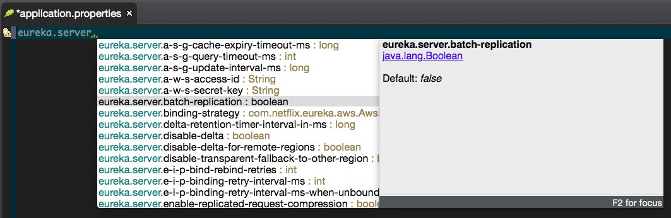
1. Eureka Server Configuration
Eureka Server – the discovery server; contains a registry of services that can be discovered
All configuration under the eureka.server prefix
EurekaServerConfigBean

Slide 45
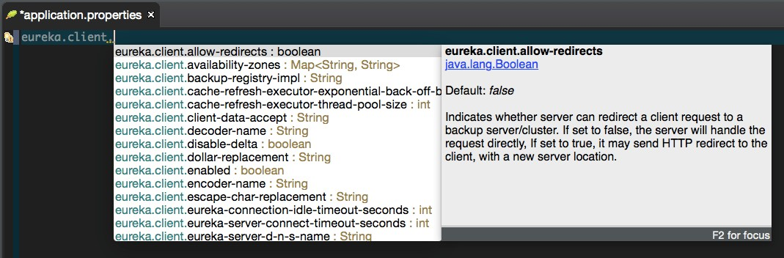
2. Eureka Client Configuration
Eureka Client – anything that can discover services
All configuration under the eureka.client prefix
EurekaClientConfigBean

Slide 46
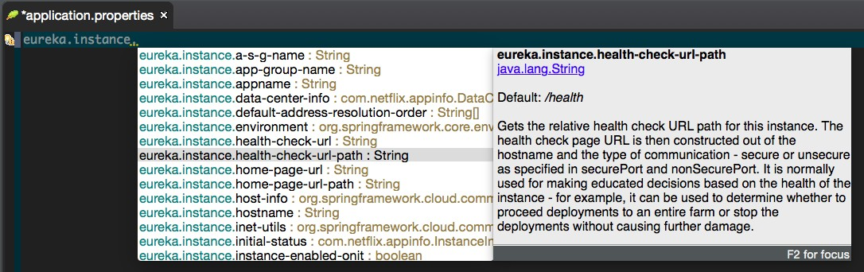
3. Eureka Instance Configuration
Eureka Instance – anything that registers itself with the Eureka Server to be discovered by others
All configuration under the eureka.instance prefix
EurekaInstanceConfigBean

Slide 47
Spring Cloud Eureka: Health & High Availability

Slide 48





Eureka Server: Are My Services Healthy?
Regularly checks the status of services
Clients send heartbeats every 30 sec (default)
Services removed after 90 secs of no heartbeats (default)
Can customize configuration to use
/health endpoint
eureka.client. healthcheck.enabled

Slide 49
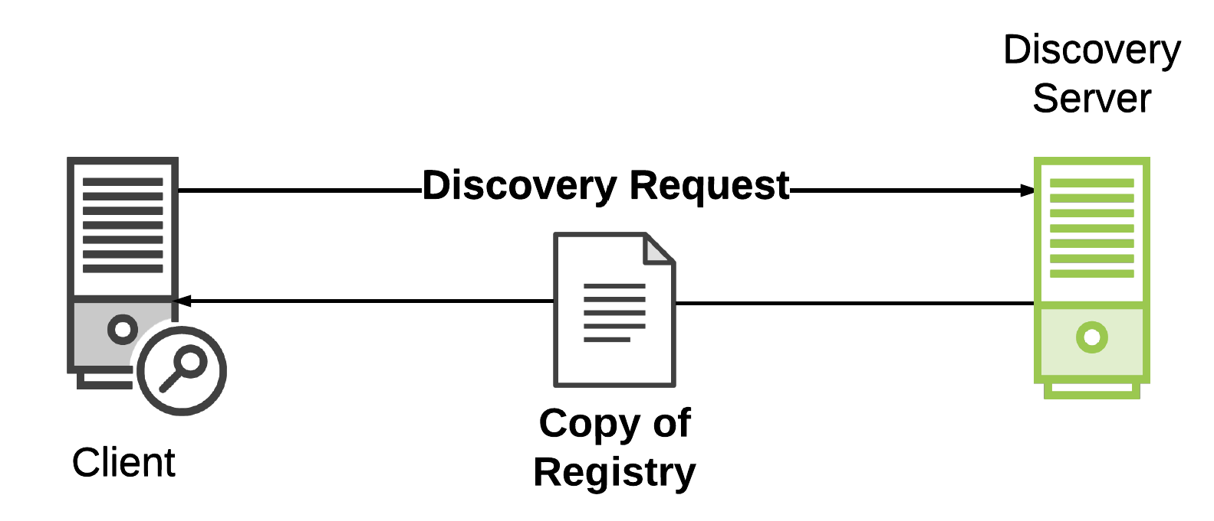
The registry is distributed (cached locally on every client)
Clients can operate without discovery server
Fetches deltas to update registry

Slide 50
Spring Cloud Eureka AWS Support

Slide 51
Spring Cloud Eureka is AWS Aware
AWS-specific instance data
Multi-zone aware
Multi-region aware
Elastic IP Binding

Slide 52
Configuring Spring Cloud Eureka for AWS
@Configuration
public class AppConfig {
@Bean
public EurekaInstanceConfigBean eurekaInstanceConfig( InetUtilsProperties properties)
{
EurekaInstanceConfigBean bean = new
EurekaInstanceConfigBean(new InetUtils(properties));
AmazonInfo info = AmazonInfo.Builder.newBuilder().autoBuild("eureka"); bean.setDataCenterInfo(info);
return bean;
}
}

Slide 53
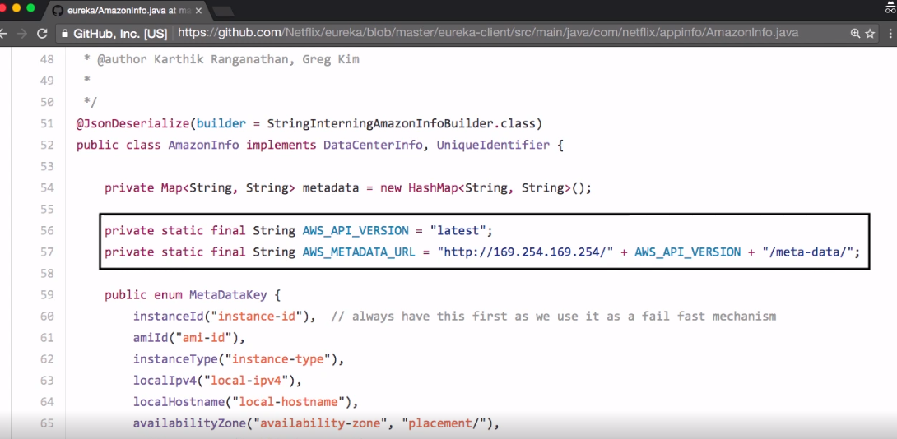

Slide 54
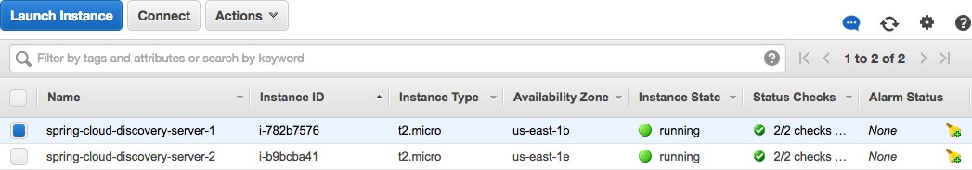
EC2 Dashboard
us-east-1
eureka.client.availability-zones.us-east-1=us-east-1b,us-east-1e
Availability Zones Configuration in application.properties
eureka.client.availability-zones.[region]=[az1],[az2],[az3]

Slide 55
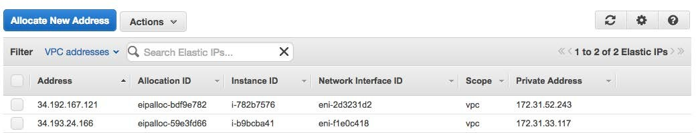
Elastic IP Dashboard
us-east-1
eureka.client.service-url. us-east-1b=
http://ec2-34-192-167-121.compute-1.amazonaws.com:8761/eureka/
eureka.client.service-url. us-east-1e=
http://ec2-34-193-24-166.compute-1.amazonaws.com:8761/eureka/
Service URL Configuration in application.properties
eureka.client.service-url.[zone]=http://[eip-dns]/eureka
- * Use EIP DNS name. Do not use IP (as of version Eureka 1.4)

Slide 56
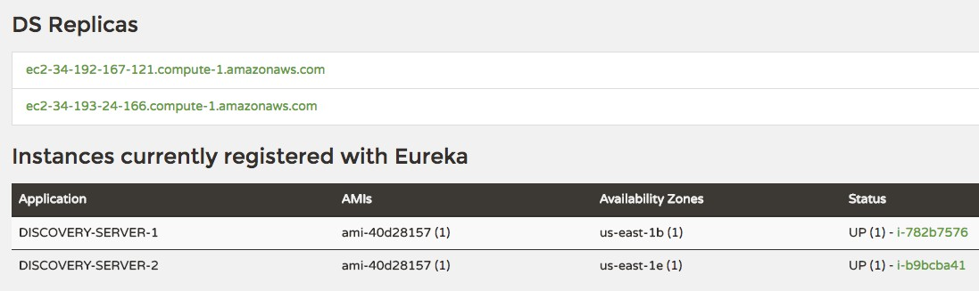
Eureka Dashboard: AWS Multi-zone Discovery Servers

Slide 57
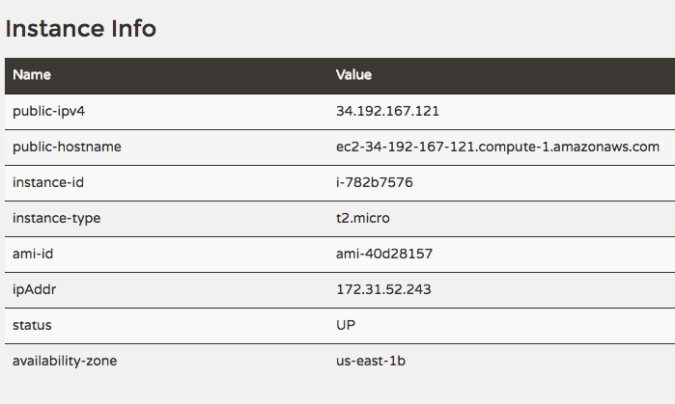
Eureka Dashboard: AWS Instance Data

Slide 58
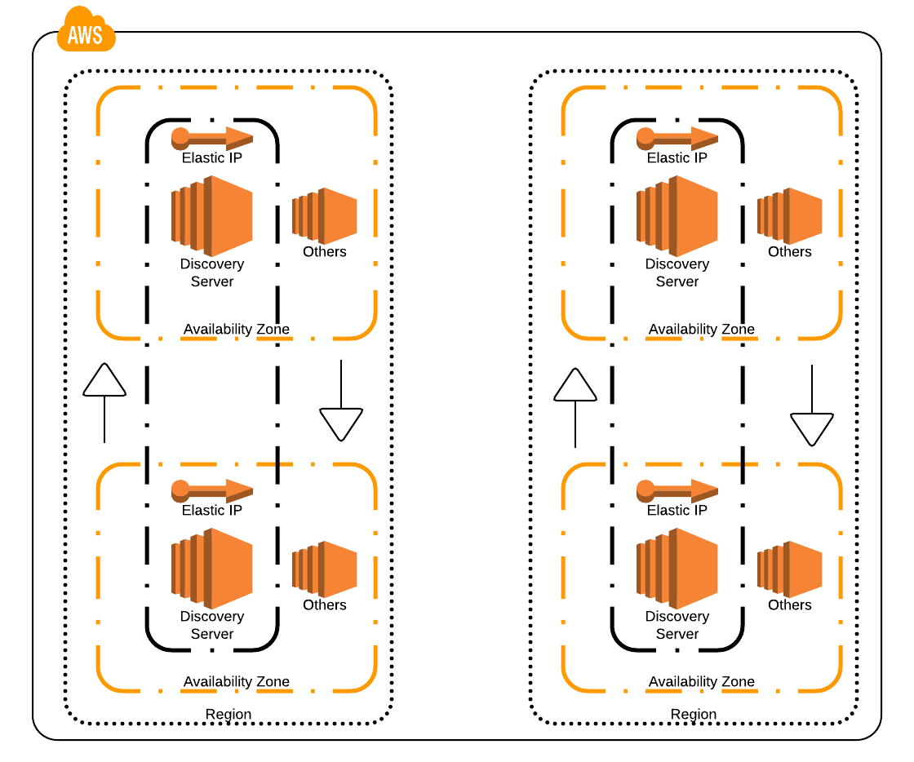
Auto scaling groups evenly across zones
One or more discovery servers (DS) per zone
One EIP (static) per Discovery Server

Slide 59
What is service discovery and why is it important?
Using the Spring Cloud Eureka Client & Server
Spring Cloud Eureka Dashboard Health & High Availability Configuring Spring Cloud Eureka AWS Support
Summary

